Slide 1
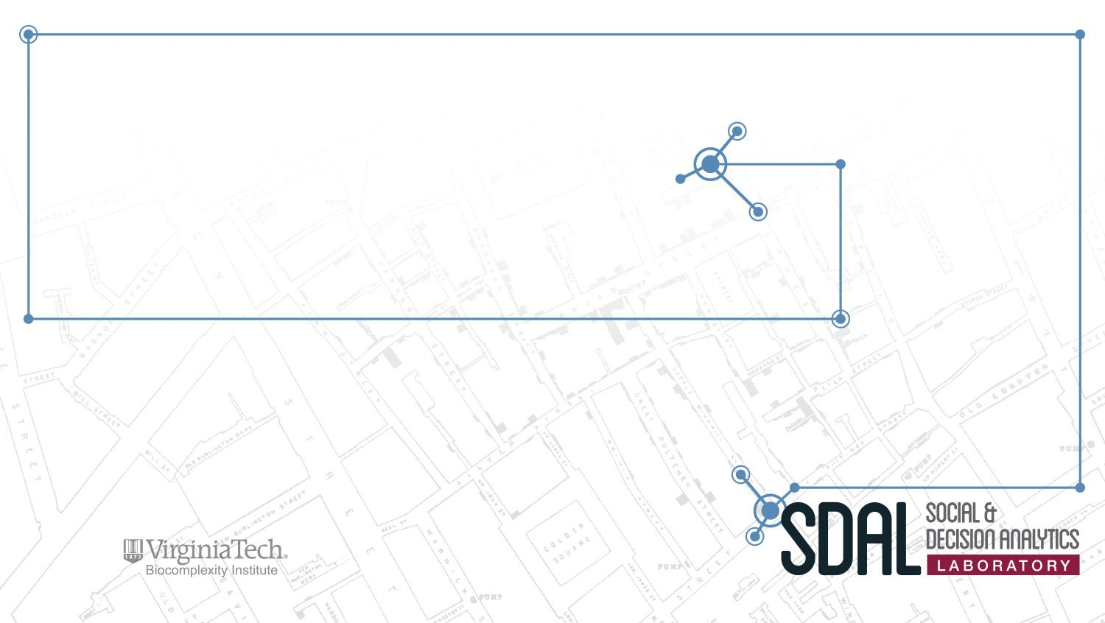
Virginia Tech
Student Lifecycle Metrics
PI: Aaron Schroeder
SDAL Leads: Gizem Korkmaz & Sallie Keller
SDAL Team: Devika Nair, Jay Warajuntano, Doug Mattingly
Sponsor: Virginia Tech

Slide 2
Agenda
Research Questions
Project Plan
Research Areas
  Admissions
  Progression
  Outcomes
Next Steps
Notes:
i.e., they are not captured in surveys nor are in economics measures such as the Gross Domestic Product (GDP).

Slide 3
Research Questions
Admissions
How do students respond to acceptances? What patterns accompany students who choose to enroll elsewhere?
Student Success
How do students perform throughout their 4 years at Virginia Tech? What patterns characterize students struggling to complete their studies?
Post-Graduate Outcomes
Are graduates able to achieve their desired career goals within 6 months of completing their VT degree?
Goal:
To understand how low-income and/or minority students trend throughout their lifecycle at Virginia Tech.

Slide 4
Project Plan
Deadline: July 15
Variable Adjustments
  Transforming variables
  Creating new variables
  Linking data
Deadline July 31
Modeling
  Prediction generation
  Subset comparisons
Deadline: August 5
Presentation
  Poster Preparation
  Presentation Practice
Deadline: June 30
Data
  Quality Review
  Fitness Evaluation
  Identification of key identifiers
Approach
  Topic Selection
  Method Selection

